Slide 1
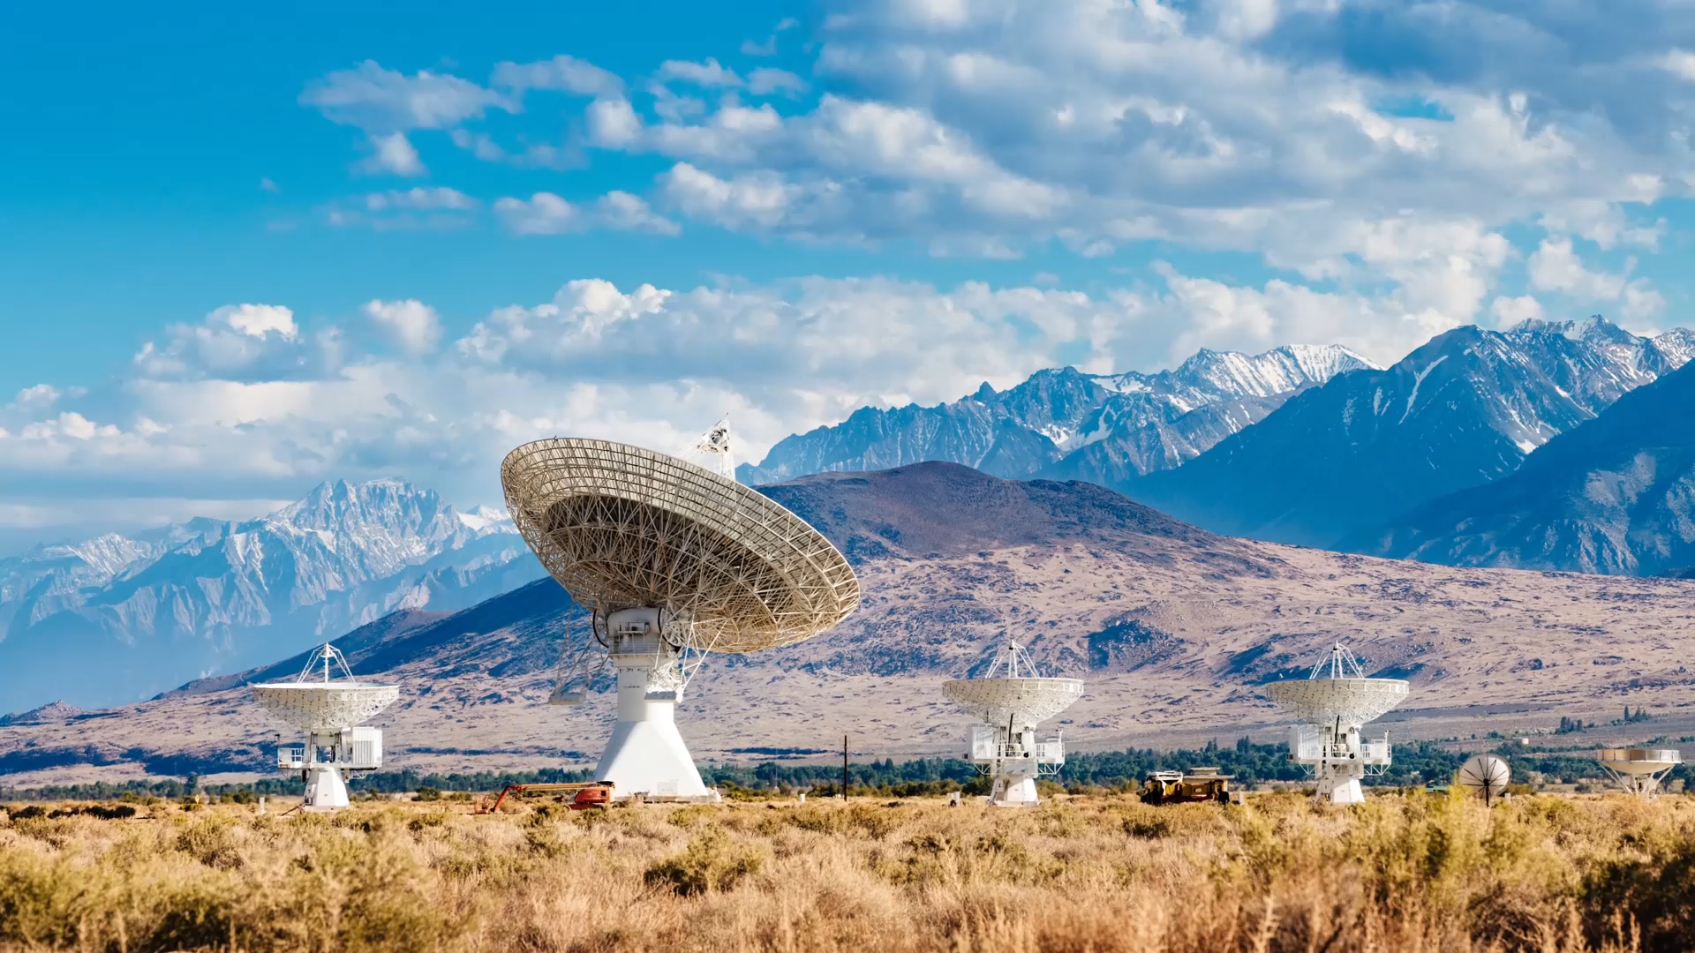
GPS for Farmbot
By Tracy MacAulay-Higgan

Slide 2
Problem I wanted to solve
I wanted to add a GPS unit to Farmbot so we could see where it had been with a track and get some real time information on where Farmbot is at any given time, while the GPS is running.

Slide 3
Problems faced during the project
Some issues I ran into were trying to work with the com port, this was a bit temperamental
I also had issues getting the correct data off the GPS – turns out I was using an incorrect library to base the code off.
I tried to also get WIFI added but I had issues with the hardware – turns out a lot of other people have had the same issue

Slide 4
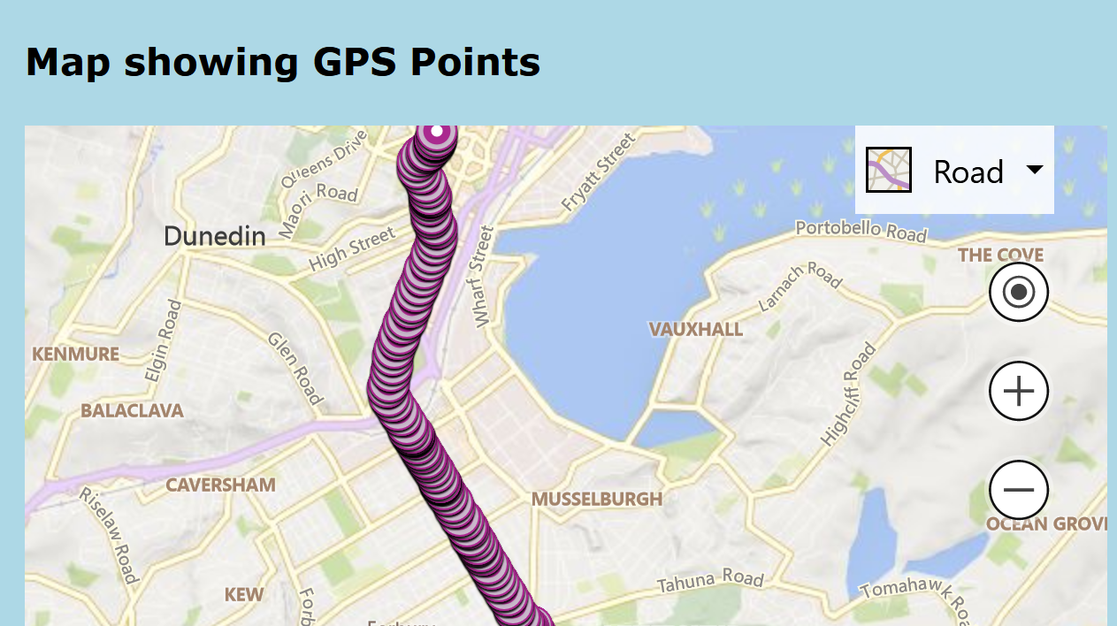
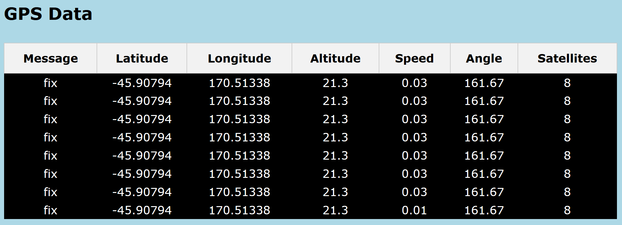
Finished product
This is a still of the finished product each dot is a new point

Slide 5
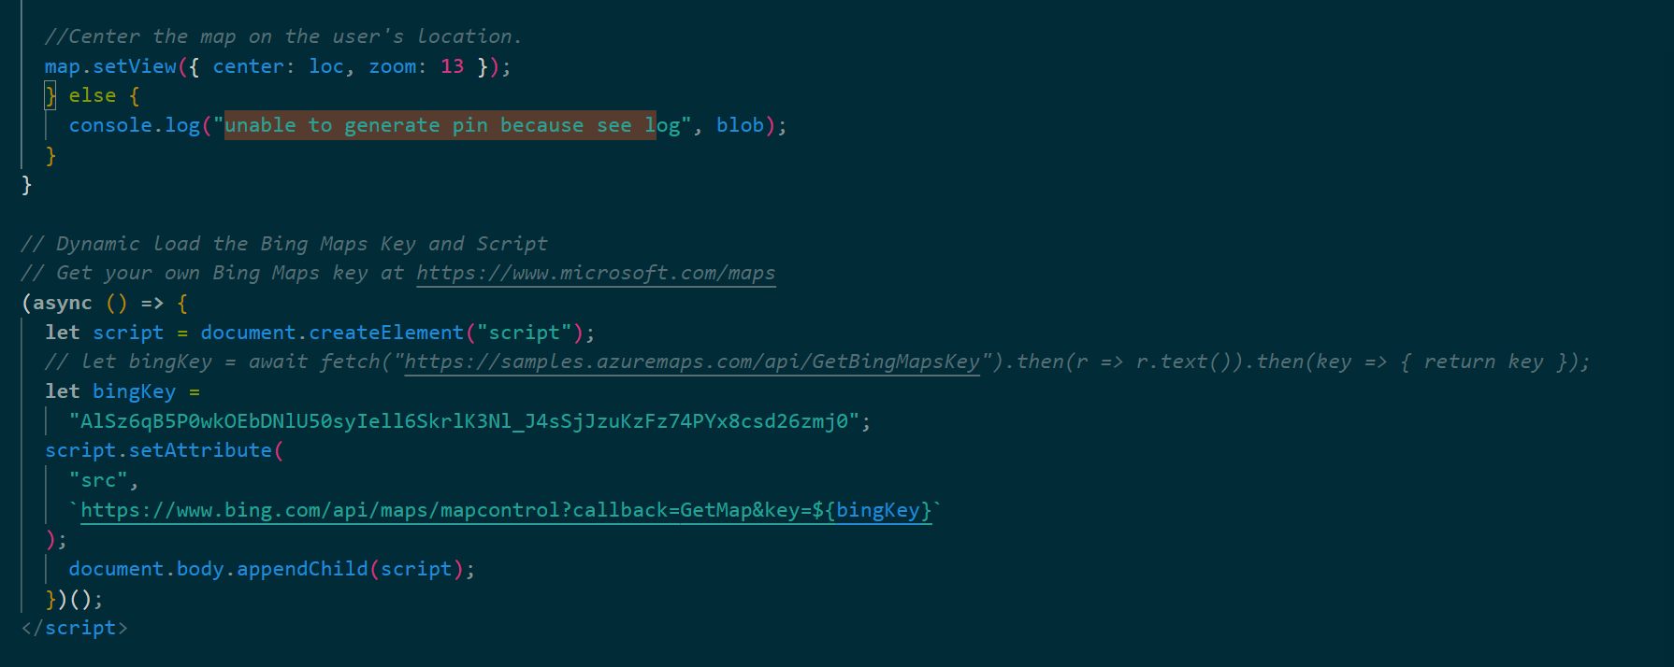
Code samples
This is using a bing maps API to pull the map data
It also sets how zoomed the map is

Slide 6
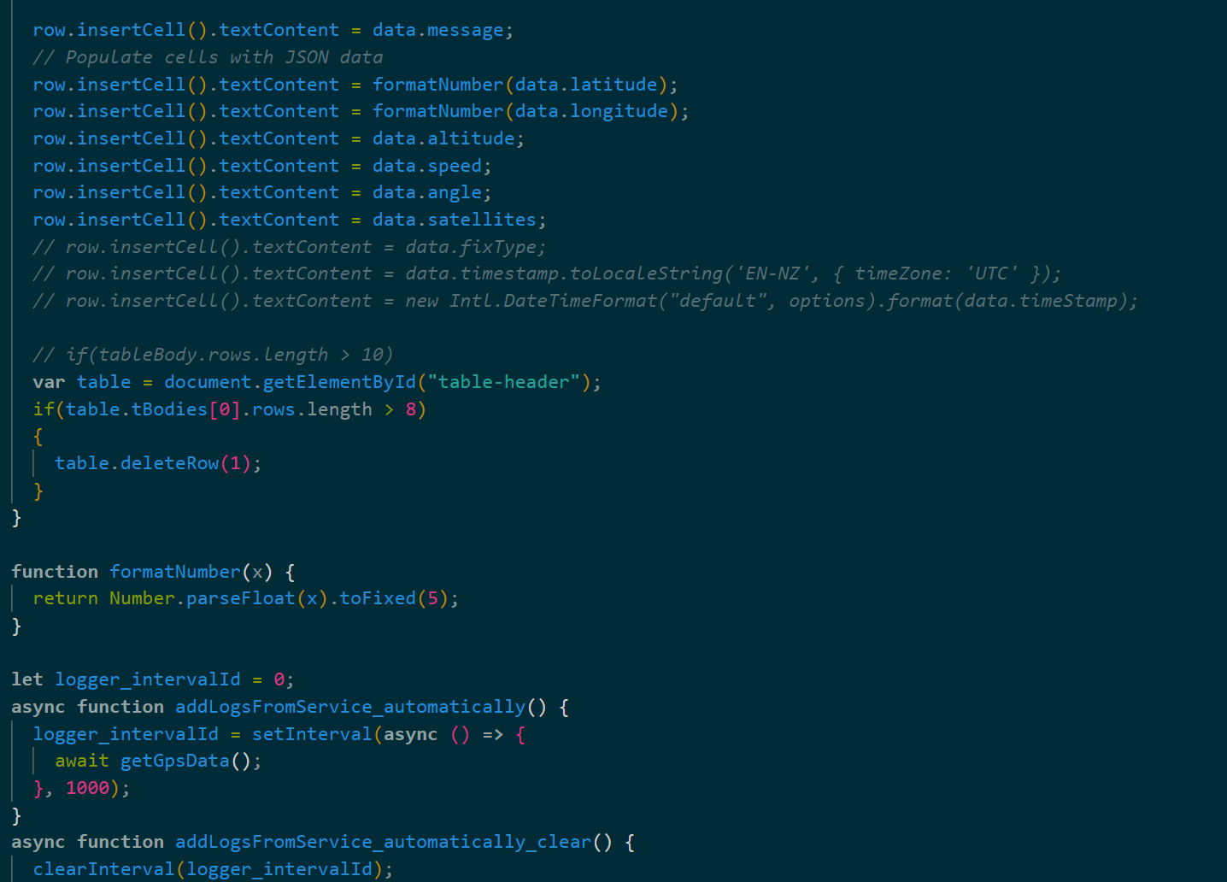
More
Setting up my table to display the data

Slide 7
Testing
This was tested firstly with “fake” data to make sure the GPS was writing data to the screen and the point was updating its location.
Then with real data on a car drive recording the screen to show the point moving during the trip.

Slide 8
Reflection
On reflection I did get the GPS working as I had wanted to but I did want to also try and get some WIFI working. This proved to be a bigger challenge than I had anticipated. While this piece did not work I am still happy with the finished product.
I would have liked to be able to add the functionality to be able to put in coordinates and send it somewhere but this can be for another project
The project I have completed gets the GPS data and plots it on a map and as the user moves the data updates and the pin moves to reposition. It doesn’t put line but there is a line of pins showing the track
GPS will also be good to be able to send Farmbot places like to get coffee, but this is something for another time.

